Slide 2
OPEN SOURCE CONTRIBUTION
MSA JGI EVENT

Slide 3

CONTENTS :
INTRODUCTION
WHAT IS OPEN SOURCE AND OPEN SOURCE CONTRIBUTION?
OPPORTUNITIES IN OPEN SOURCE
STEPS TO ENTER OPEN SOURCE WORLD
STEPS TO DO THE OPEN SOURCE CONTRIBUTION
OPEN SOURCE PROGRAMS

Slide 4
INTRODUCTION :
Android powers more then 86 percent in the world .
VLC player is the most popular media player in the world .
Wikipedia comprises more then 55 millions articles attracting 1.7 billion unique visitors per month .
Mozilla Firefox is now the second most used web browser .
Linux run on everything including smartphones , servers , submarines and space rockets
Why we are talking about this ?

Slide 5
ANSWER IS SIMPLE…
We are talking about this because these all are based on the open source .
But the biggest question lies here is what is open source ?
OPEN SOURCE CONTRIBUTION 2 So let's go and explore this in more brief .

Slide 6


WHAT IS OPEN SOURCE ?
It is defined as source code that is made freely available for possible modification and redistribution .
It means the source code of the open source software are public .
It means you can play with the code , modify it , remove the bugs from it . This openness enables collaboration .

Slide 7

OPEN SOURCE CONTRIBUTION…
It means contributing to the development or improvement of open - source software .
It boost the chances of getting the opportunity in the big firms like google and all .

Slide 8

OPPORTUNITIES IN OPEN SOURCE :
EXPERIENCE
It gives us the opportunities to work with great software engineers around the world which helps in building the connection.
It also helps us to get in touch with the community and market.
BENEFITS
It helps in learning best code practices.
Helps in building online reputation.
Makes your resume powerful and attraction.
It helps you to write and learn the clean code practices.
It helps you to improve our communication skills.

Slide 9

4 GOLDEN STEPS TO ENTER THE OPEN SOURCE WORLD :
LEARN A SKILL
Web development.
Android development.
Machine learning.
Technical writing.

Slide 10

4 GOLDEN STEPS TO ENTER THE OPEN SOURCE WORLD :
LEARN VERSION CONTROL
Basic git command.
Forking a project .
Commit and push your changes .

Slide 11

4 GOLDEN STEPS TO ENTER THE OPEN SOURCE WORLD :
FIND AN ORGANISATION
In order to do the open source contributions you will have to find the open source software.
So , There are several ways in order to do the open source contributions.
You can find the opportunities in the big players like Firefox and android which have the big user base and community in which lot of changes and things are required.
Once you introduce the changes then millions of people can see the changes.

Slide 12

4 GOLDEN STEPS TO ENTER THE OPEN SOURCE WORLD :
FIND A BUG / FEATURE
Most of the organization have "Good first issue "tag which helps beginners contribute easily .
Beginners can also find issues by themselves and fix them .
OPEN SOURCE CONTRIBUTION 4 You can also find out the channels on telegram and slacks in order to communicate regarding the issues and bugs .

Slide 13
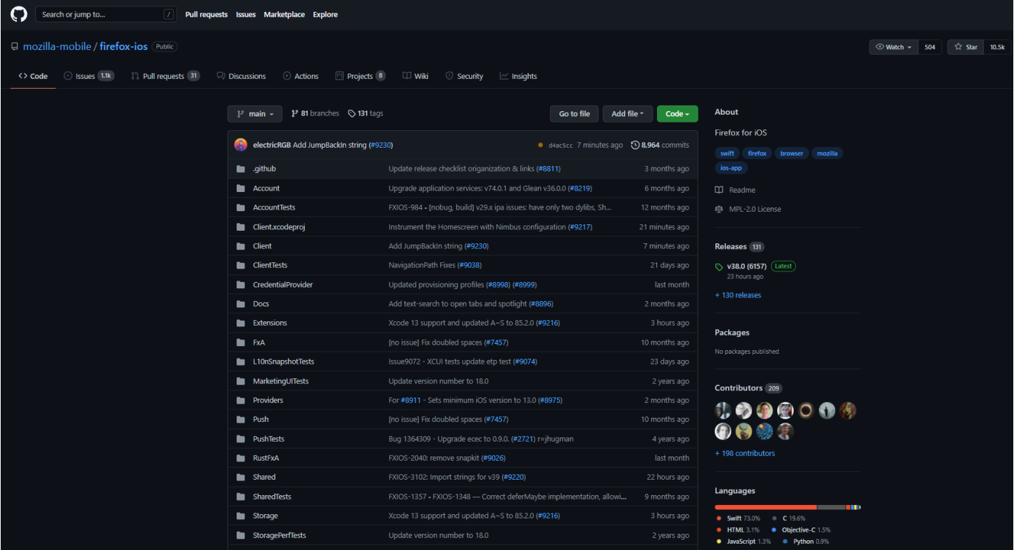
STEPS TO DO THE OPEN SOURCE CONTRIBUTION
Search for the project on the open source hosting website like GitHub.
In this we will take the use of git hub in order to perform our open source contribution.
So we will have to setup the program locally in order to make an open source contribution.

Slide 14
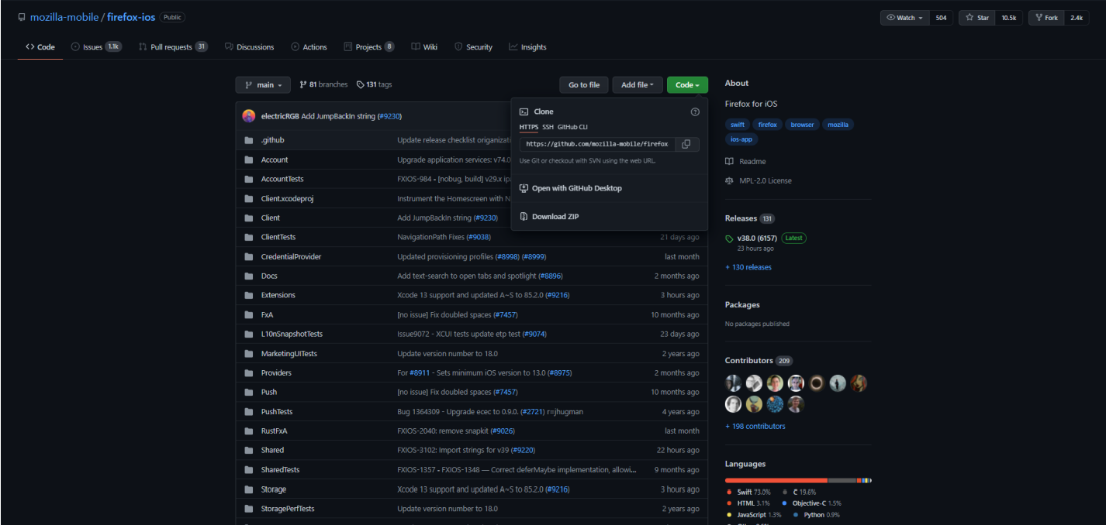
STEPS TO DO THE OPEN SOURCE CONTRIBUTION
So for that clone the code from GitHub and just copy the link.

Slide 15
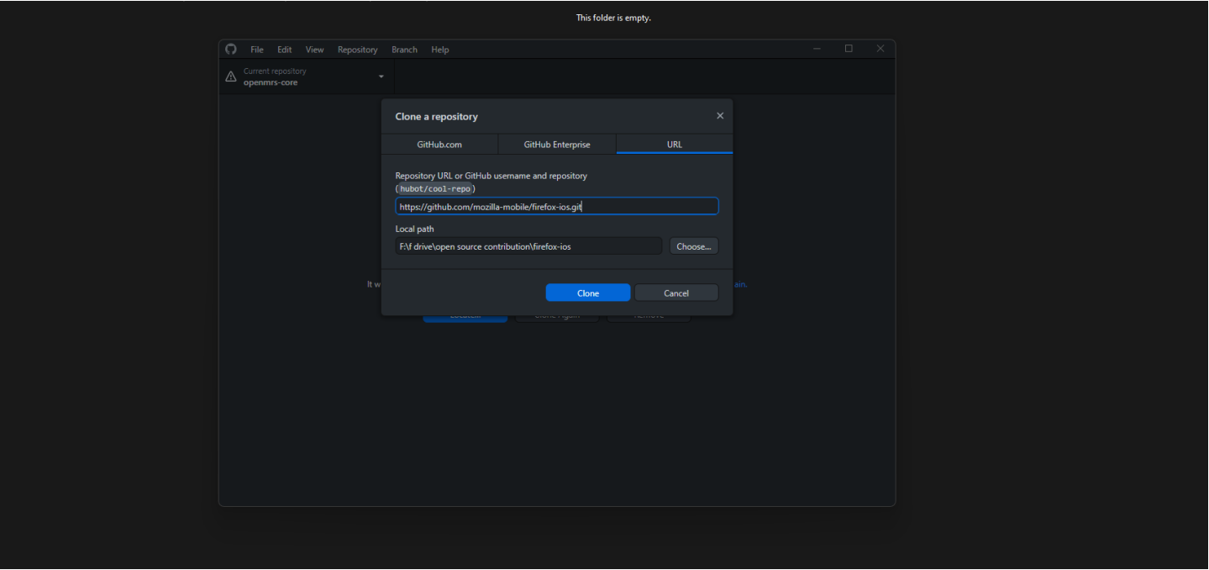
STEPS TO DO THE OPEN SOURCE CONTRIBUTION
Now create an folder in the local system and open git desktop .
Now in the git desktop click on the clone the repository and select the clone from URL option and paste the URL and click on the clone and select the location .

Slide 16

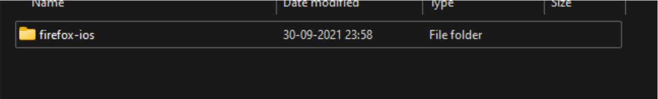
STEPS TO DO THE OPEN SOURCE CONTRIBUTION
Now then you will see that the new folder is created and in that all the files are located .
Then you check the issue section in the GitHub , where all the issues or the bugs are labelled or written .

Slide 17
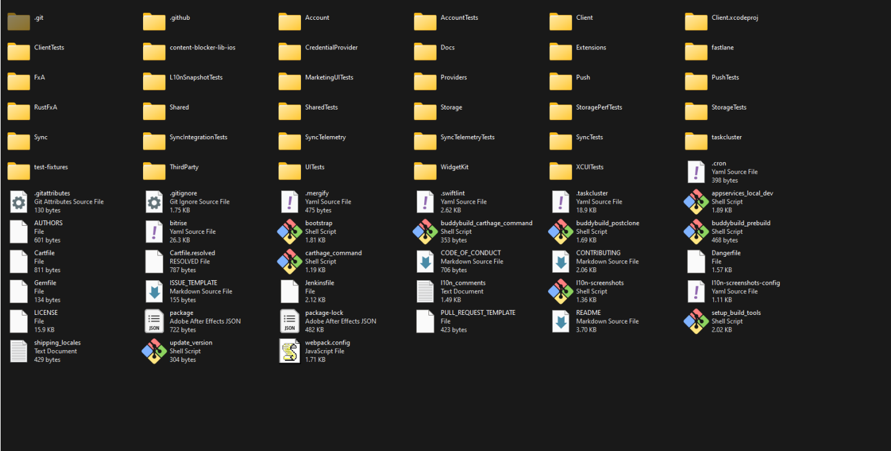
STEPS TO DO THE OPEN SOURCE CONTRIBUTION

Slide 18
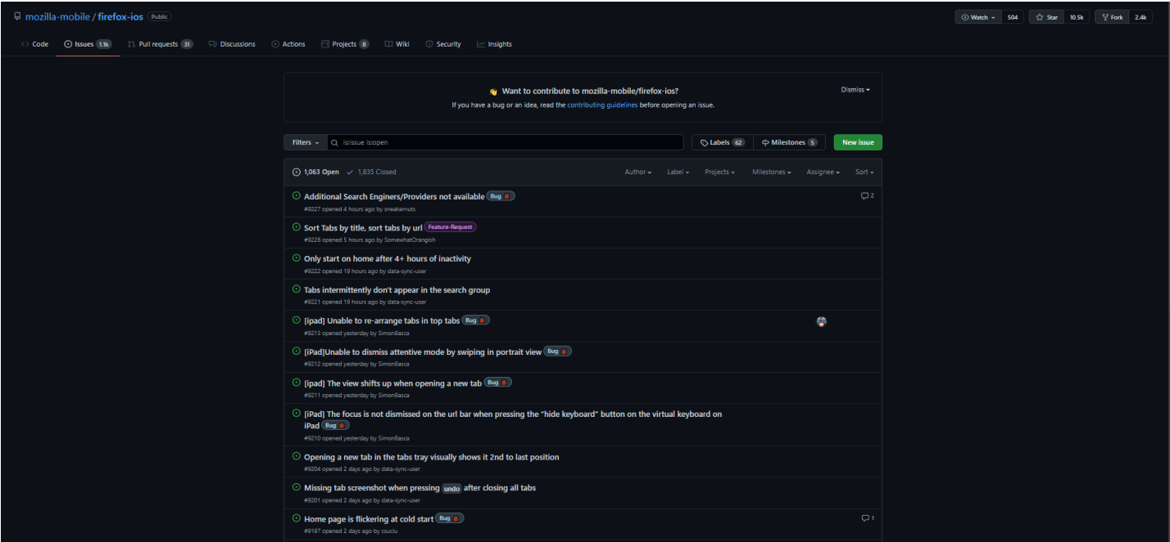
STEPS TO DO THE OPEN SOURCE CONTRIBUTION

Slide 19
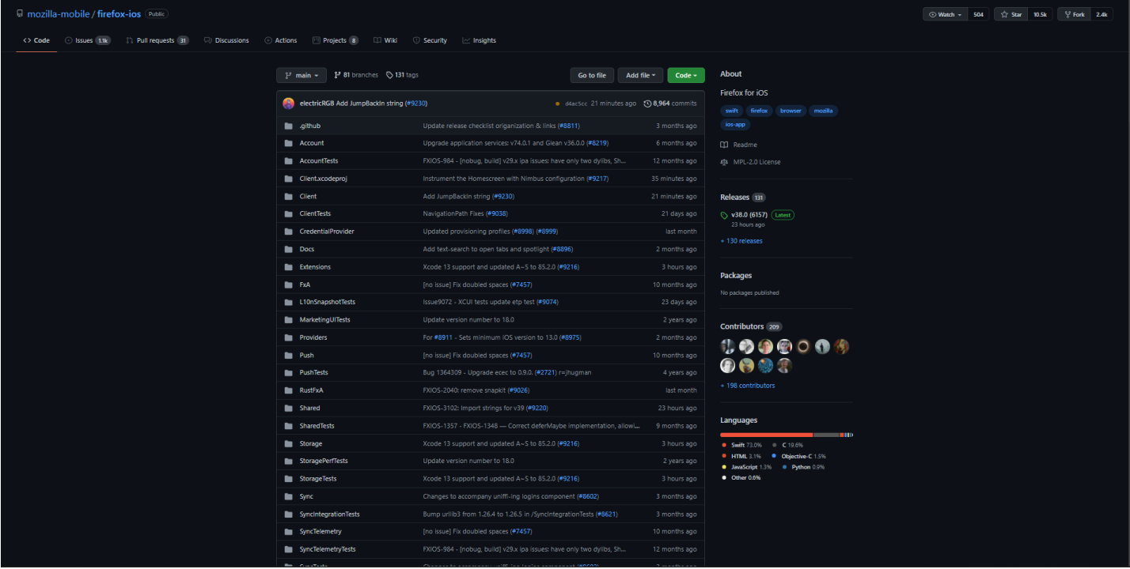
STEPS TO DO THE OPEN SOURCE CONTRIBUTION
There find out the label "good first issue" if you are beginner because it includes all the issue tasks .
Then try to fix the issue in your local environment by using your skills.
In the end we will push the code in the open source repository.
For pushing the contribution in the repo we will take first add then we will commit and in the end we will create an push request.
Then fork the repository , it will create an copy of the repository in your account.

Slide 20
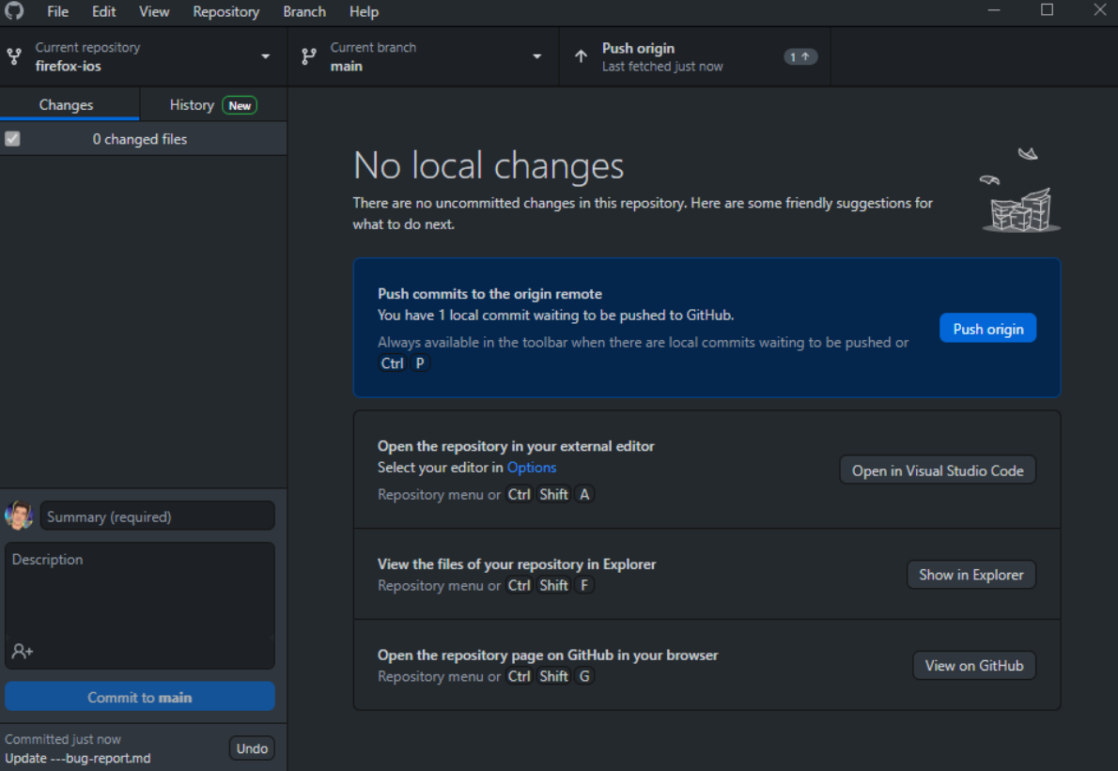
STEPS TO DO THE OPEN SOURCE CONTRIBUTION
Then after pushing the code in the branch origin we will create an pull request .

Slide 21
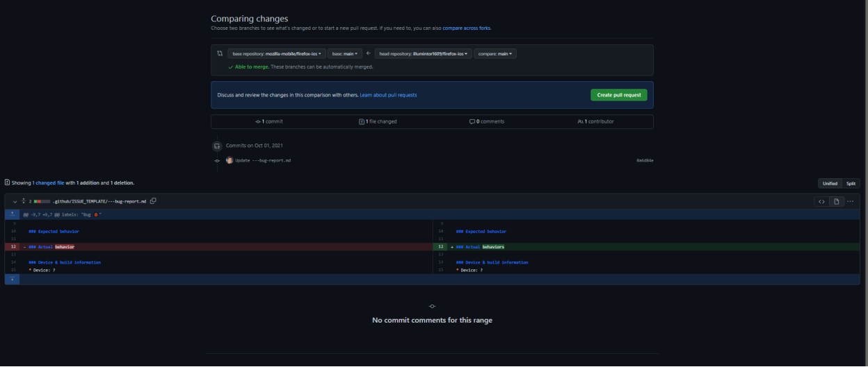
STEPS TO DO THE OPEN SOURCE CONTRIBUTION
After this your pull request will become open and in the end the other maintainers will check the pull request and if your pull request is genuine then they will merge this into their master branch .
Just click on the pull request.
I am not doing this because this is not an valid request or the bug which we have fixed.
So I hope you have understood the process of open source contributions.

Slide 22
OPEN SOURCE PROGRAMS
Some of the popular open source programs are :
GOOGLE SUMMER OF CODE
https://summerofcode.withgoogle.com/
OUTREACHY
https://www.outreachy.org/
MLH FELLOWSHIP
https://fellowship.mlh.io/
GIRLSCRIPT SUMMER OF CODE
https://gssoc.girlscript.tech/
RAILS GIRLS SUMMER OF CODE
https://railsgirlssummerofcode.org/
GOOGLE SUMMER OF DOCS
https://developers.google.com/season-of-docs/docs/faq/
GOOGLE CODE IN
https://codein.withgoogle.com/archive/
MICROSOFT OPEN SOURCE PROGRAM
https://www.microsoft.com/en-us/research/academic-program/rl-open-source-fest/
OPEN SOURCE CONTRIBUTION 10 LFX MENTORSHIP PROGRAM
https://mentorship.lfx.linuxfoundation.org/#projects_all/
CNCF MENTORING
https://github.com/cncf/mentoring
LFN MENTORSHIP PROGRAM
https://wiki.lfnetworking.org/display/LN/LFN+Mentorship+Program
LINUX KERNAL MENTORSHIP PROGRAM
https://wiki.linuxfoundation.org/lkmp X.ORG
ENDLESS VACATION OF CODE
https://www.x.org/wiki/XorgEVoC/
JULIA SEASON'S OF CONTRIBUTION
https://julialang.org/
SUMMER OF HASKELL
https://summer.haskell.org/
OPEN MAINFRAME PROJECT MENTORSHIP PROGRAM
https://www.openmainframeproject.org/projects/mentorship-program
OPEN SUMMER OF CODE (OSOC)
https://osoc.be/
HYPERLEDGER MENTORSHIP PROGRAM
https://wiki.hyperledger.org/display/INTERN/Hyperledger+Mentorship+Program

Slide 23

OPEN SOURCE PROGRAMS
PROCESSING FOUNDATION FELLOWHSHIP OPEN SOURCE CONTRIBUTION 11
https://processingfoundation.org/fellowships/
HACKTOBER FEST
https://hacktoberfest.digitalocean.com/
FOSSASIA CODEHEAT
https://codeheat.org/
DRIVEN DATA COMPETITION
https://www.drivendata.org/competitions/
KUBERNETES RELEASE TEAM SHADOWS
https://github.com/kubernetes/sig-release/blob/master/release-team/shadows.md

Slide 24
THANKS

